Slide 1

PCWG 2016 Update
Wednesday, 13 December 2016
Glasgow, Scotland
Peter Stuart

Slide 2
We’ve Always Known that Real World Wind Turbine Performance is NOT as Simple as Power=P(v, ρ)!
Extract from C.J. Christensen et al: ”Accuracy of power curve measurements”, Risø-M-2632, 1986...
”… The power curve is then seen as the relation between the power P(v) produced by this undisturbed wind v.
This definition is, however, of very doubtful value for a windmill in the natural wind. The main difficulty is that it assumes a smooth laminar flow of high degree of homogeneity and symmetry”
ρ = Air Density
P=P(v, ρ)
Power (P)
Wind Speed (v)
The PCWG aims to build industry consensus on how best to predict real world turbine performance and look beyond P=P(v, ρ). www.pcwg.org.

Slide 3
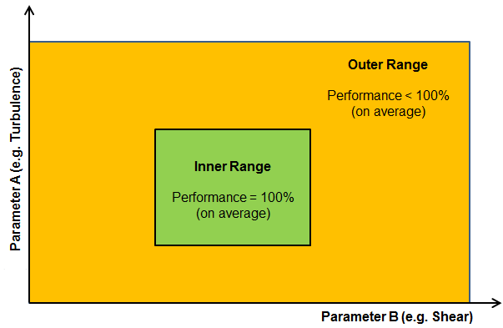
Reflecting the Real World…
Categories of Turbine Performance Corrections
Inner Range Performance
Adjustments to reflect the fact that even under warranted/ideal conditions performance may not be 100%
Outer Range
Outer Range Performance
Adjustments to reflect the fact that turbine performance may deviate from Inner Range behaviour in Outer Range Conditions
e.g. Low/High TI, Low/High Shear etc.
Inner Range
+ Other Performance Corrections
Icing, Blade Degradation, Sub-optimal performance etc.
Note: The PCWG Inner-Outer Range Proposal is Conceptual Decomposition, and does infer specific parameter ranges.

Slide 4

Reflecting the Real World: Inner Range Performance
Historic Performance Under Inner Range Conditions
The PCWG is seeking to design an adjustment framework to define how to make best use of historic power performance tests when predicting future turbine performance.
Extract from ‘High Resolution Turbine-Specific Matrix’, Carl Ostridge DNV GL,
Colorado PCWG Meeting, 10 August 2016, download from www.pcwg.org.

Slide 5
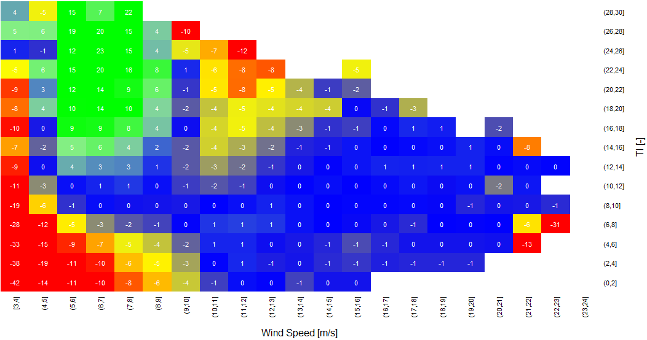
Reflecting the Real World: Outer Range Performance
Inner Range Performance
Outer Range Deviations (Observed – Base)
Colour = % Observed Power Deviation
(Observed - Base)
High TI & High V
Negative Deviation
High TI & Low V
Positive Deviation
Power (P)
P=P(v, ρ)
Turbulence Intensity [%]
Low TI & Low V
Negative Deviation
Wind Speed (v)
Wind Speed [m/s]
The PCWG is attempting to evaluate methods for predicting Outer Range performance via the PCWG Intelligence Sharing Initiative (PCWG-Share-X)

Slide 6
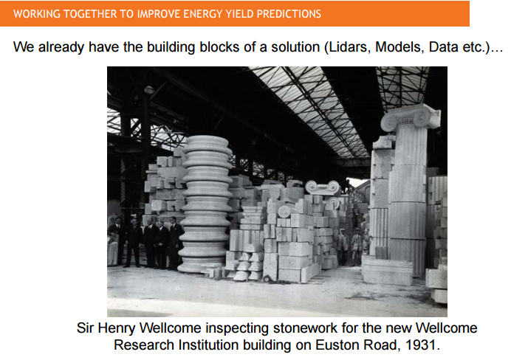
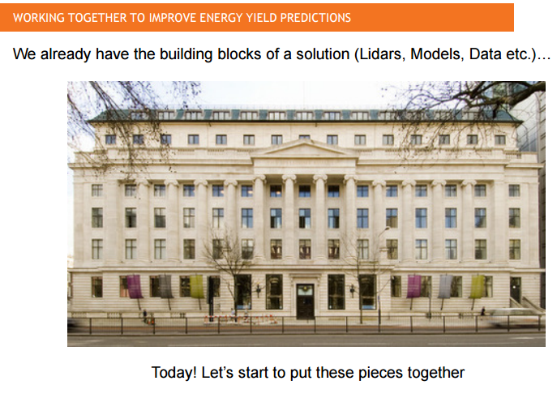
21 PCWG Meetings Later…
The PCWG has been meeting since December 2012 and has held a total of 21 meetings in Europe and the US. It currently has a membership of over 300 people.
At the first presentation at the first meeting it was noted how the ‘building blocks’ for solving the issues at hand already existed.
http://www.pcwg.org/proceedings/2012-12-04/WTWG-04Dec2012-01-MA-RES-Power-Curve-Workshop-Introduction.pdf
Today, this ‘building blocks’ statement is truer than ever!

Slide 7
Where is the PCWG on the issue of turbine performance in outer range conditions?
2014 Results
Far from Consensus
Political Dimension
Close to Consensus
Close to Certainty
Far From Certainty
Technical Dimension

Slide 8
Where is the PCWG on the issue of turbine performance in outer range conditions?
2015 Results
Far from Consensus
Political Dimension
Close to Consensus
Close to Certainty
Far From Certainty
Technical Dimension

Slide 9
PCWG Intelligence Sharing Initiative Update
PCWG-Share-1.1

Slide 10
PCWG-Share-X: What are we Trying to Achieve?
Motivation:
Solution:
There are currently many candidate methods for predicting turbine performance in outer range conditions, but no consensus about which method works best.
The Power Curve Working Group Intelligence Sharing Initiative (PCWG-Share-X) aims to objectively test many methods for predicting outer range turbine performance in order to determine which works best.
The industry has a wealth of historic power performance data whose full potential is yet to be realised.
The Power Curve Working Group Intelligence Sharing Initiative (PCWG-Share-X) aims to unlock the full value of our industry’s data.
The PCWG Intelligence Sharing Initiative enables the industry to pool the value of many datasets without actually sharing any commercially sensitive data.

Slide 11
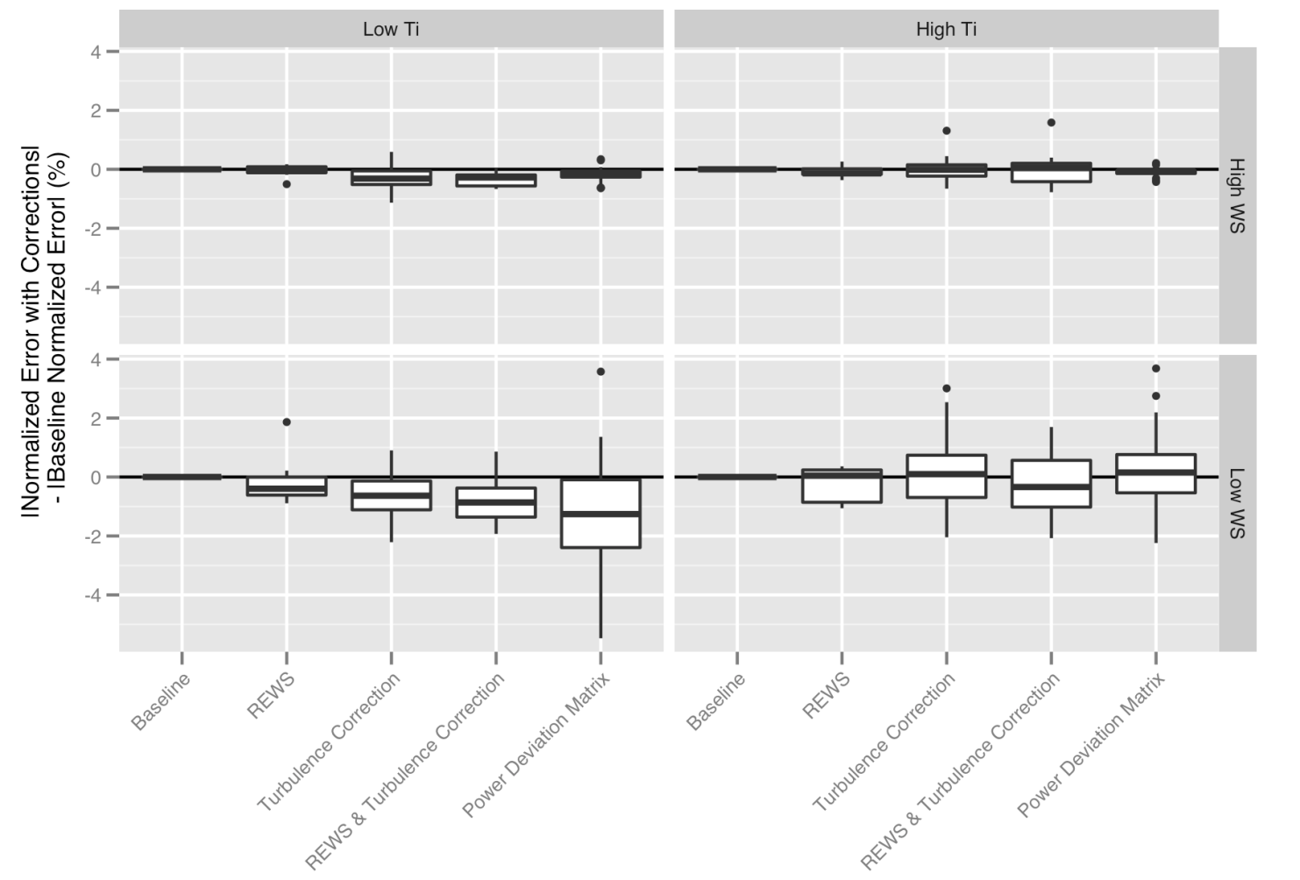
PCWG-Share-1.1 Comparison of Methods (‘Four Cell’ Matrix)
Low Turbulence
High Turbulence
Worse
Seek to determine which methods work well when.
High Wind Speed
Better
Percentage Reduction in Error
PCWG-Share-2 to expand upon these results.
Worse
Low Wind Speed
Better
Baseline
REWS
REWS
Turb Corr
Baseline
Turb Corr
REWS & Turb Corr
Power Dev Matrix
REWS & Turb Corr
Power Dev Matrix

Slide 12
PCWG-Share-X Timeline
PCWG-Share-1
≈50 participant datasets (4 remote sensing datasets)
3 method tested (REWS, IEC Turbulence Correction & Power Deviation Matrix)
Calculation Issues: Interpolation Errors and Erroneous Outliers
Dec 2015
Sept2016
PCWG-Share-1.1
≈44 participant datasets (11 remote sensing datasets)
Same 3 method tested (REWS, IEC Turbulence Correction & Power Deviation Matrix)
Streamlined participation process
PCWG-Share-1 Calculation Issues Resolved
Oct to
Dec
2016
PCWG-Share-2
Target: 100 participant datasets (25 remote sensing datasets)
Additional methods to be tested e.g. 3D Power Deviation Matrix & REWS with Upflow
Refined results analysis
Behind Schedule, sorry! (more later)

Slide 13

IEC 61400-12-1 Ed 2
Getting Ready for the New Standard
PCWG: Uncertainty Worked Examples
IEA Task 32: Uncertainty Round Robin

Slide 14
IEC 61400-12-1 Edition 2 Status
Document Stage | Document Stage Description | IEC61400-12-1 Ed 2 Status
CDV Committee Draft for Voting | Feedback Stage: Document is sent to the various National Committees for comment. Once the feedback is received the TC (Technical Committee) integrated the feedback and prepares the FDIS. | Completed
FDIS Final Draft International Standard | Approval Stage: Document is sent to the National Committees for voting. At this stage no comments or requests for change are accepted although typographical errors can be pointed out for correction by IEC prior to publication. If, after the FDIS vote, the publication is approved, no more changes of a technical nature can be made to it. Only obvious editorial mistakes can be corrected. | Complete (Nov 2016)
Publication of IS (International Standard) | Final Stage: The IEC generates the cover pages and prepares the document for publication. The document is published and put on sale in the IEC Web Store. Note that editorial errors not captured prior to publication can still be issued as corrigendum by IEC throughout the life of a specific publication. | Expected Early 2017
The PCWG in collaboration with IEA Task 32 are seeking to build industry understanding of the new Power Performance Standard. www.pcwg.org.

Slide 15
IEA Task32 & PCWG Activities Timeline (2016)
IEC Round Robin
IEC Worked Examples
Jul & Aug
Distribution of round robin dataset and instructions to participants.
Initial round robin results presented at Pamplona and Minneapolis PCWG meetings.
Second round robin initiated, results due by end of October.
Collation of final results
Presentation of final results at PCWG meeting in Glasgow.
Preparation of work examples.
Presentation of full suite of worked examples at September PCWG Meetings. Release of worked examples on PCWG DropBox.
IEA32 & PCWG members to review worked examples and provide feedback.
Public publication of work examples after Dec PCWG meeting (www.pcwg.org)
Sept
Oct
Nov
Dec

Slide 16
Agenda Overview
13 December 2016

Slide 17
Agenda Overview (Morning)
09.30 - 10.00 Introductions & Welcome
09.30 - 09.40 Welcome from our hosts, Owen Murphy, ORE Catapult
09.40 - 10.00, PCWG Update/Overview, Peter Stuart (RES)
10.00 - 11.00: PCWG-Share-X Results (Intelligence Sharing Initiative),
10.00 - 10.40: Results Presentation, Peter Stuart (RES) & Andy Clifton (NREL)
10.40 - 11.00: Q&A
11.00 - 11.10: Coffee Break
11.10 - 11.25: Machine Learning Sub Group Presentation, Andy Clifton (NREL)

Slide 18
Agenda Overview (Morning & Early Afternoon)
11.25 - 12.20: Preparing for 61400-12-1 Ed 2
11.25 – 11.40: 12-1 Ed 2 Round Robin Results Overview, Luke J Simmons, DNV GL
11.40 – 11.55: 12-1 Ed 2 Work Examples Overview, Lee Cameron, RES
11.55 – 12.10: 12-1 Ed 2 Worked Examples Feedback, Axel Albers, WindGuard
12.10 – 12.20: Q&A
12.20 – 13.00: Morning Presentation Session:
12.20 – 12.35: “Nacelle Lidar measurements of the Induction Zone from Multiple Offshore Wind Farms”, Frederik Brink, Dong Energy
12.35 – 12.40: Q&A
12.40 – 12.55: “Turbine performance – Veer”, Matthew Colls, Prevailing
12.55 – 13.00: Q&A

Slide 19
Agenda Overview (Afternoon)
13.00 - 14.00: Lunch
14.00 - 14:40: Afternoon Presentation Session:
• 14.00 – 14.15: “Evaluating The Wind Resource From Rotor Equivalent Wind Speeds.”, Christiane Montavon , ANSYS
• 14.15 – 14.20: Q&A
• 14.20 – 14.35: ‘Blade Leading Edge Erosion Project‘, Owen Murphy, ORE Catapult
• 14.35 – 14.40: Q&A
14.40 - 15.00: Break & Adaptive Problem Exercise
15.00 - 16:00 Afternoon Discussion Session:
• The Future of the PCWG
• PCWG-Share-X Next Steps
16.00 – 16.30: Wrap Up

Slide 20
Join the Power Curve Working Group at: www.pcwg.org

Slide 21
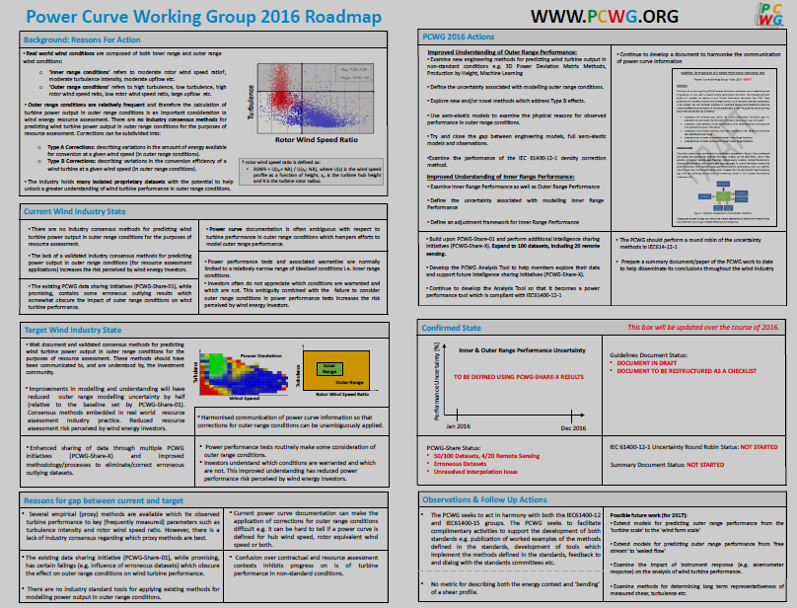
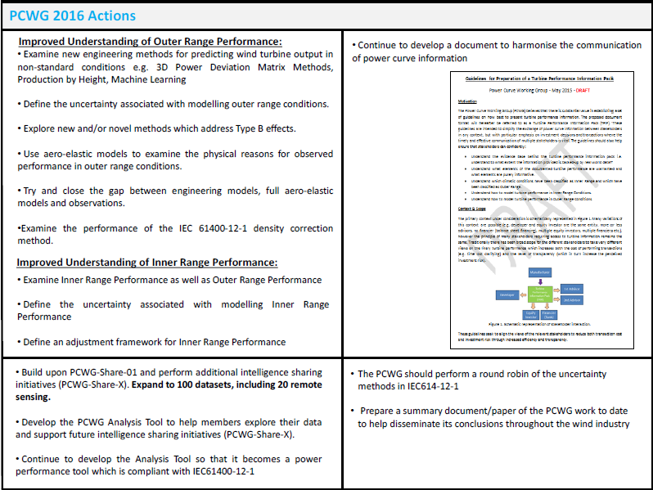
Priority Actions (what we are working on right now)
Note: as IEA Task 32 also planned a IEC61400-12 Round Robin the PCWG has focused on worked examples.

